Slide 1

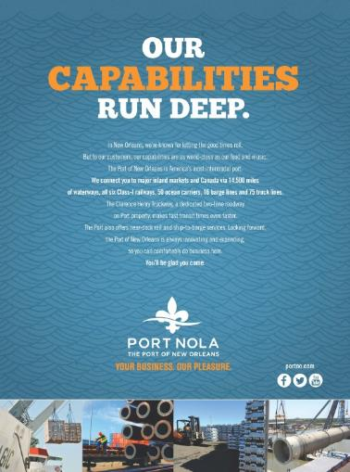

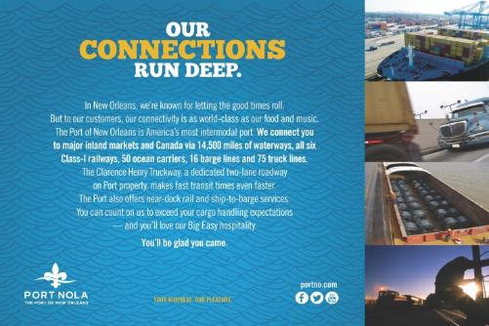

Port of
New Orleans
Our Connections
Run Deep ad campaign
Ad Series
Use this area for logo
(delete text box before placing logo)

